Slide 1



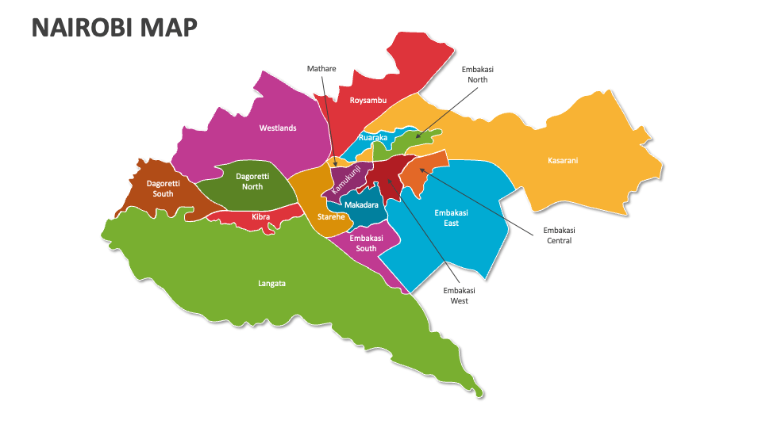
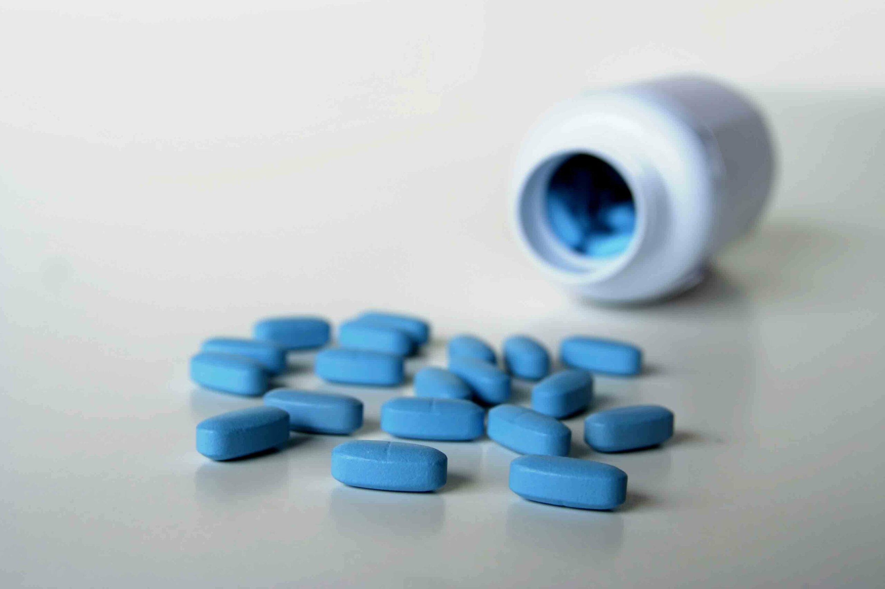
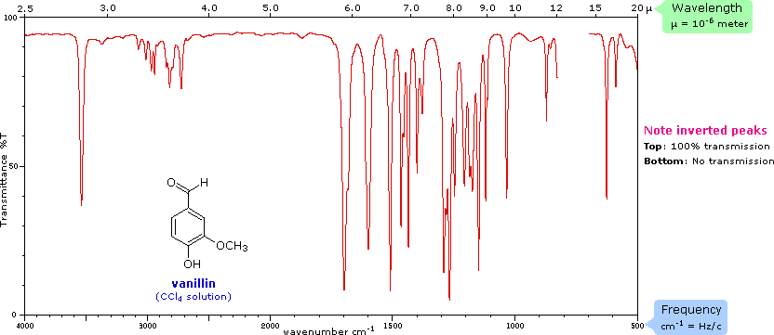
THE BLUE PILL SYNDROME - FROM ENHANCEMENT TO DEPENDENCY; A PUBLIC HEALTH CRISIS
Catherine Serah Murambi
Clinical and Forensic Toxicology Laboratory
Government Chemist Department
Nairobi, Kenya
BACKGROUND
The prevalence of counterfeit regimes remains a global health challenge intensified by globalization, internet accessibility, and high profitability associated with low risks for this type of trafficking. Viagra (Sildenafil) use in Kenya has fundamentally shifted the landscape of male sexual health, evolving from treatment of clinical erectile dysfunction (ED) into a widely used lifestyle drug for the modern man.
OBJECTIVE:
To investigate the various forms of Viagra (authentic and falsified) seized in Nairobi County, ascertain their chemical composition, and any adulteration. It will also assess medical insights and lurking dangers from Viagra misuse..
METHODOLOGY: There is a widespread misuse and abuse of Viagra by men seeking to boost sexual performance. This has been aggravated by unsupervised use that has led to increased cases of severe health complications hence the need to assess the chemical composition therein, ascertain the levels of active ingredients and any chemical contaminations.
.
STUDY AREA: Nairobi, Kenya
STUDY DESIGN AND SAMPLING
Quantitative Research
Involved simple random sampling. A total of 30 authentic Viagra tablets were selected, and 94 falsified tablets were selected from 15 different seizures.
INSERT MAP OR FIGURES
INSERT GRAPHICAL
INSERT GRAPHICAL
STATISTICAL ANALYSIS: The SPSS software was used to Analyse Quantitative.
RESULTS
DISCUSSION
Chemical Composition of Authentic Samples and Suspected
falsified samples.
From table A. Out of 94,Suspected falsified samples ,42 were confirmed as counterfeit while 18 tested positive for Ecstasy., a controlled psychotropic substance, and 5 contained harmful chemicals of boric acid and blue paint used in printing. Notably, the Active Pharmaceutical Ingredient was <25%, below the threshold
.4% of deaths in Nairobi per month is attributable to Viagra use.
Table A..
 | Analyzed Samples | No. | Counterfeit | Positive for Ecstasy | Positive for harmful chemicals | API content
1 | Authentic samples | 30 | - | - | - | >96.0%
2 | Suspected Falsified samples | 94 | 42 | 18 | 5 | <25.0%
2. Every month, 80 deaths are conclusively investigated, 3 of which are as a result of Viagra poisoning.(Nairobi county).
CONCLUSIONS
1.The risk of Viagra use for sexual enhancement has culminated into severe health complications including death. Many victims continue to self prescribe yet they suffer from underlying health conditions like high blood pressure and diabetes. The situation has been exacerbated by the increase in counterfeit regimes posing serious public health concerns.
Contact:katemurambi@gmail.com]
MOSES KIMANI

